Slide 1

Sales performance Dashboard
By Swapna Macha

Slide 2
Contents
Project Brief
Dataset Overview
Problems or challenges in the Dataset
Data Cleaning and Transformation Process
Insights and Findings
Recommendations

Slide 3
Project Brief
-
The Sales Performance Dashboard project utilizes Power BI to analyze sales data.
Aims to uncover trends and provide actionable insights for business improvement.
Focuses on key metrics such as revenue, profit, and sales trends.
Offers an interactive visualization platform for stakeholders to explore data.
Helps optimize business performance through data-driven decision-making.

Slide 4
Dataset Overview
The dataset contains sales-related information, including:
Metrics: Sales, profit, revenue, and quantity.
Dimensions: Product categories, regions, and time periods.
Hierarchy: Region → Country → City.
Provides a comprehensive view of sales performance across multiple dimensions.

Slide 5
Problems or Challenges in the Dataset
Data Quality Issues: Missing values in sales and profit columns.
Data Format Discrepancies: Inconsistent date and currency formats.
Outliers: Extreme values in sales figures required normalization.
Data Relationships: Lack of predefined relationships between tables.

Slide 6
Data Cleaning and Transformation Process
Cleaned and standardized raw data in Excel.
Handled missing values through interpolation or exclusion.
Established relationships between tables in Power BI for cohesive analysis.
Created calculated measures using DAX for advanced metrics like profit margin.

Slide 7
Insights and Findings
High-Performing Regions: Region A contributed the highest revenue, while Region B showed strong growth potential.
Seasonal Trends: Sales peaked during specific holiday months, highlighting opportunities for targeted campaigns.
Product Performance: Category X had the highest revenue, while Category Y showed potential for improvement.
Profit Margins: Identified regions and products with low margins requiring cost optimization.

Slide 8
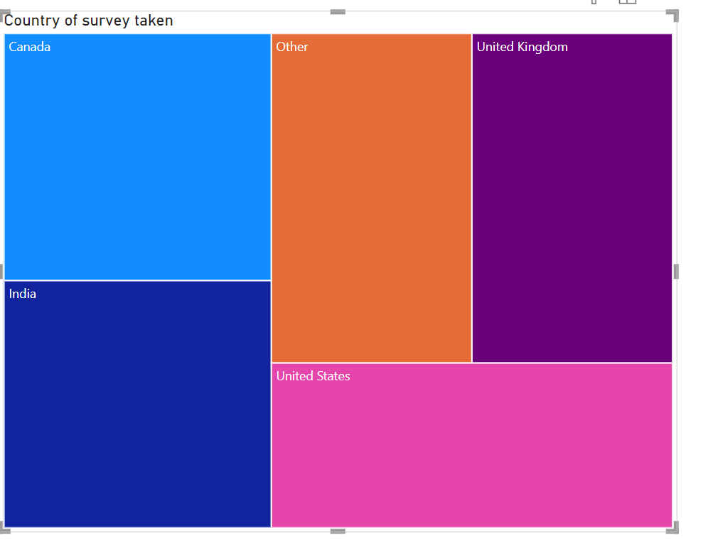
Most survey responses were gathered from the United States, followed by India and Canada.
Other countries also contributed but to a lesser extent, highlighting the global reach of the survey.

Slide 9
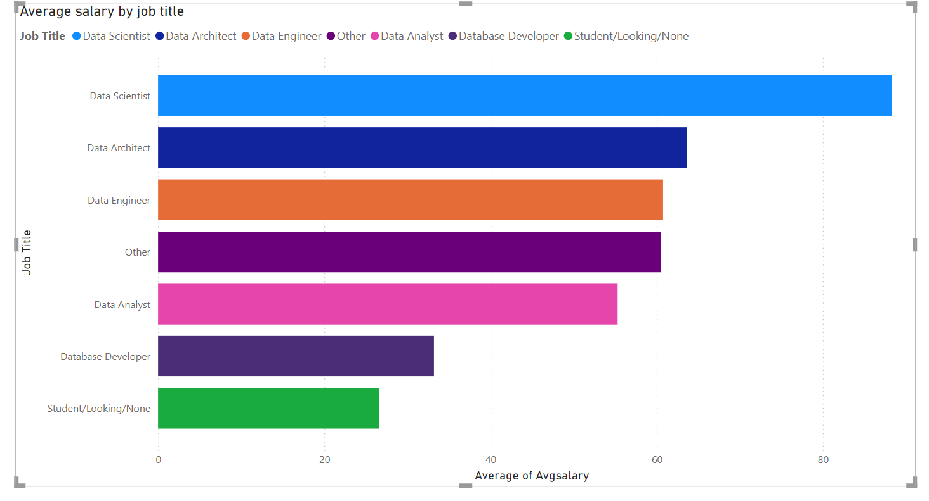
Data Scientists and Data Architects have the highest average salaries among surveyed job titles.
Data Analysts and Database Developers earn significantly less on average, indicating a salary gap based on roles within the data field.

Slide 10
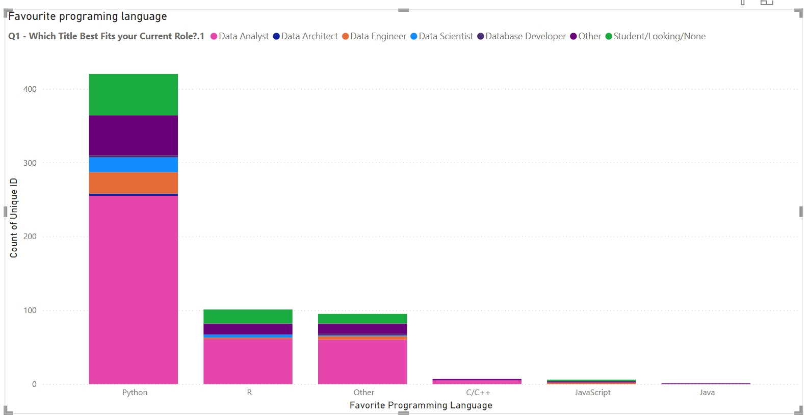
Python is the most popular programming language across all data roles.
R is the second favorite, while other languages like C/C++, JavaScript, and Java have minimal usage.

Slide 11
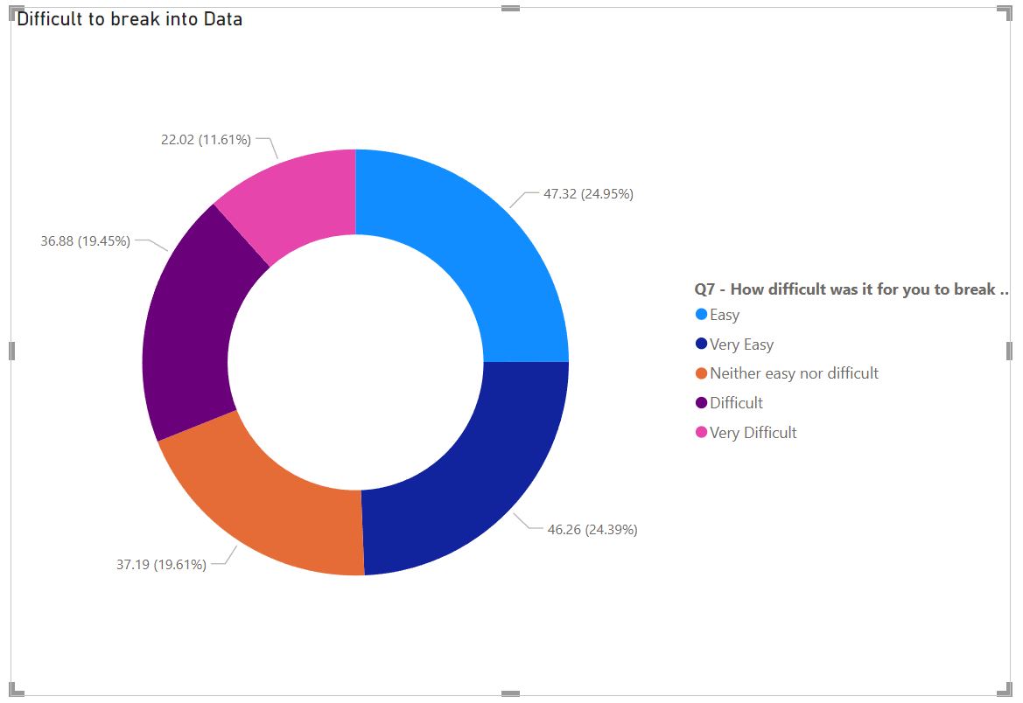
Nearly half of the respondents (47.32%) found breaking into the data field to be neither easy nor difficult.
A significant portion (24.95%) found it challenging, while fewer respondents (11.61%) found it very easy.

Slide 12
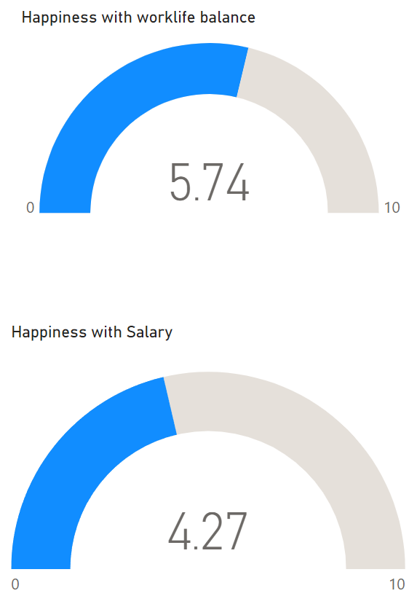
Happiness with Work-Life Balance :The average score for work-life balance happiness is 5.74 out of 10, indicating moderate satisfaction.
Happiness with Salary :The average score for salary satisfaction is 4.27 out of 10, reflecting lower satisfaction levels.
.

Slide 13
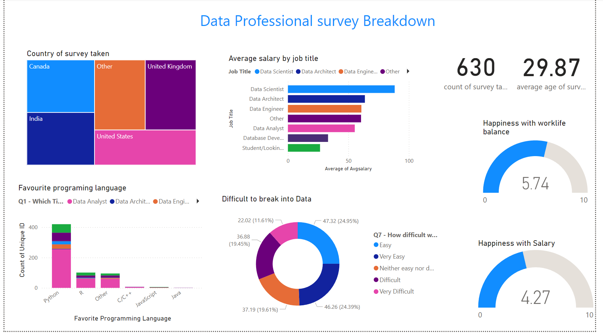

Slide 14
Recommendations
Focus on High-Performing Regions:
Allocate resources to Region A to maximize revenue.
Target Seasonal Trends:
Plan marketing campaigns during peak months to drive sales.
Improve Underperforming Categories:
Revise strategies for low-performing products like Category Y.
Optimize Costs:
Reduce costs for products and regions with low profit margins.
Leverage Dashboard Insights:
Regularly monitor dashboard metrics for real-time decision-making.

Slide 15
Thank You

